Slide 1


Cross-Organism RouteSearch
Markus Krummenacker ecocyc.org
SRI International biocyc.org
metacyc.org

Slide 2
Overview
RouteSearch (single organism)
Multi-organism RouteSearch
Implementation
GUI
Example route searches

Slide 3
Metabolic Route Search Software: RouteSearch
User specifies start compound and goal compound
Software computes minimal-cost paths from start to goal, based on reactions from
  Current PGDB, plus, optionally
  MetaCyc (15,000 reactions), as a library
Optimality criteria are to minimize:
  Number of reactions
  Number of lost atoms based on atom mappings
  Number of reactions foreign to the organism
BioCyc.org Menu: Metabolism->Metabolic Route Search
Latendresse et al., Bioinformatics 2014

Slide 4
Atom Mapping: Our Approach
Weighted Minimal Bond-Edit Distance
  Edit distance weighted by bond type and atom species
  Computed using MILP for 9,390 MetaCyc reactions
  Average time per reaction:
    73% are solved in less than 1 second
    96% are solved in less than 60 seconds
  96% of reactions had 1 or 2 solutions (with symmetries removed) – different bonds made/broken
Solution times are a function of the solver
  SCIP vs CPLEX
J Chem Inf Model. 2012 52:2970-82.

Slide 5
MORS – Multi Organism RouteSearch
Q: How are metabolites processed by a collection of organisms, such as a microbiome ?
Extend RouteSearch through an arbitrary subset of 10,980 organisms in BioCyc
Most of BioCyc was constructed by PathoLogic, using MetaCyc as a master template.
Reaction IDs are identical.
Exception: Transport reactions created by TIP (Transport Inference Parser). Ignored.
Exception: Some curated, external PGDBs may have additional reactions. Placed into the new MetaRoute PGDB.

Slide 6
Efficient Reaction Sets over BioCyc
Opening hundreds of PGDBs while searching would be prohibitive.
Solution: Pre-compute a 2D bit array of reaction IDs vs. PGDB IDs
A bit is set if the reaction is present in the PGDB. Otherwise, unset.
Precomputation takes many hours.
Pathway Tools v. 21.5+ : 16,528 reactions vs. 10,980 organisms

Slide 7
Other Pre-computed Data
PGDB Metadata (including Human Microbiome Project body sites)
MetaRoute PGDB. A copy of MetaCyc, augmented with reactions from PGDBs that are not found in MetaCyc.
Computed atom-mappings for the reactions.

Slide 8
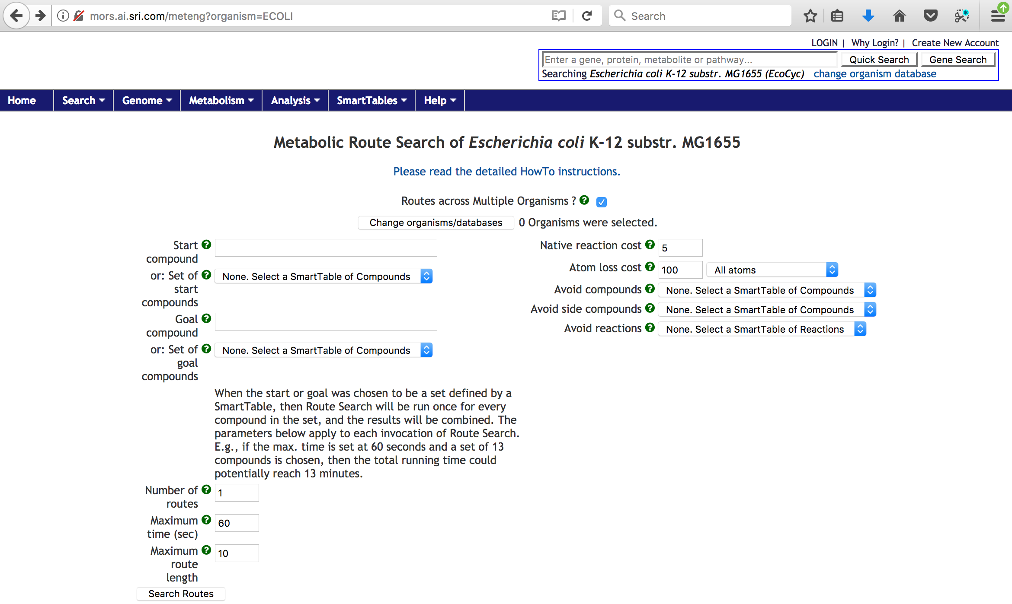
MORS mode

Slide 9
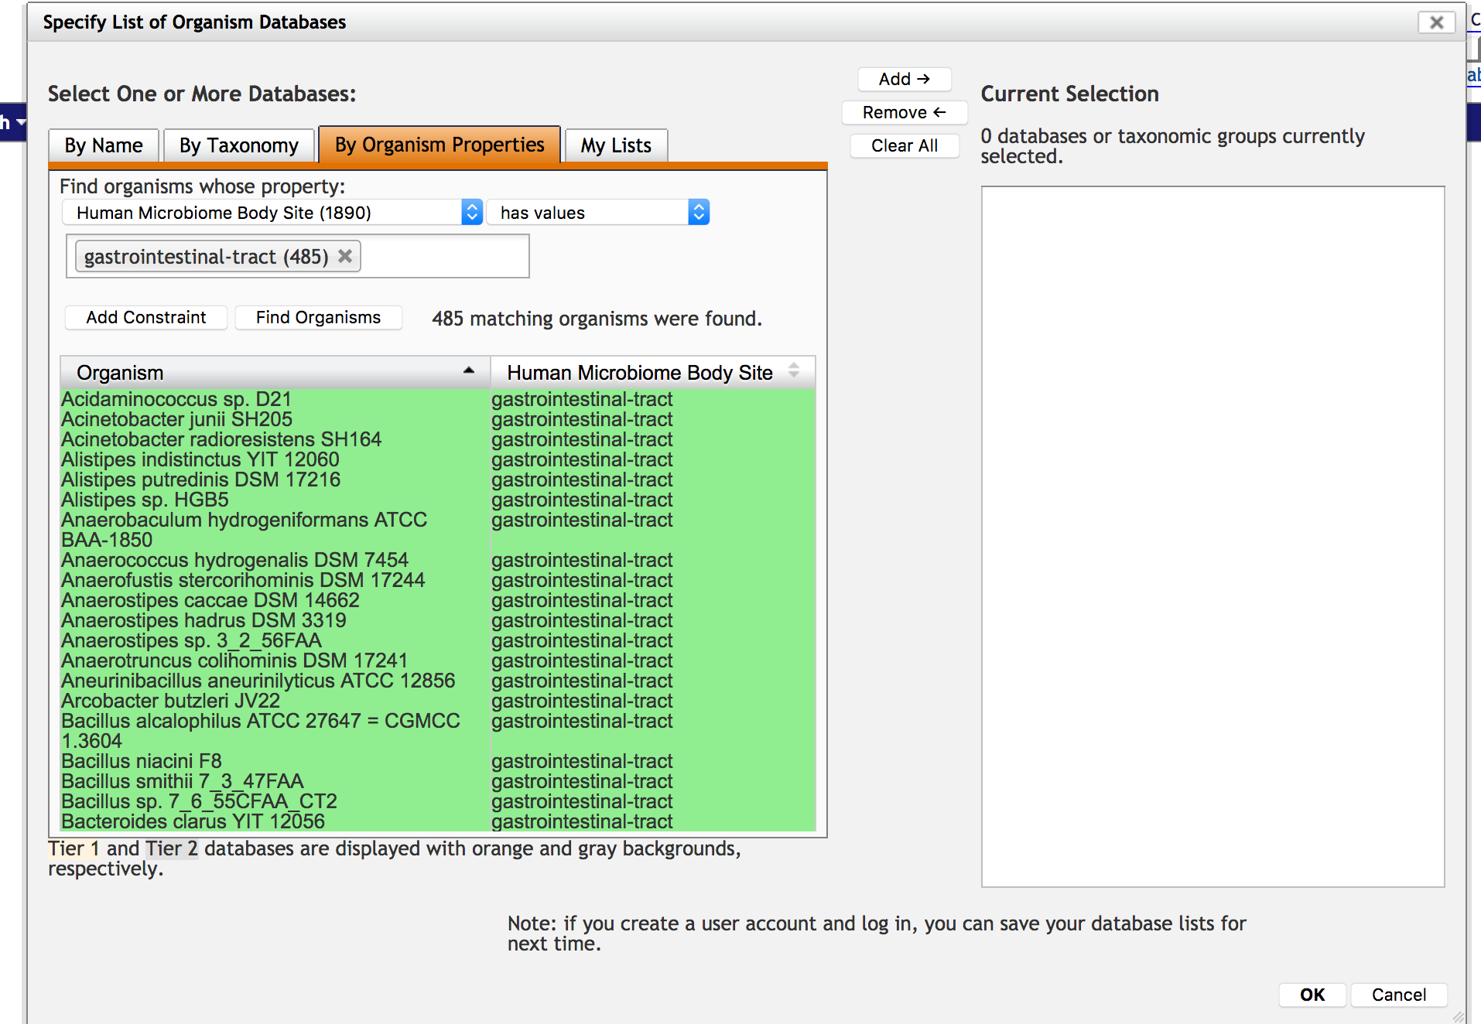
Organism selection for Microbiome body site

Slide 10
Set of Compounds as SmartTable
Either the start nor goal can be a compound set, as a SmT
One predefined set of 13 common intermediate metabolites of central metabolism :
  glucose-6-phosphate, fructose-6-phosphate
  ribose-5-phosphate, erythrose-4-phosphate, triose phosphate
  3-phosphoglycerate, phosphoenolpyruvate
  pyruvate, acetyl CoA, alpha-oxoglutarate, succinyl CoA
  oxaloacetate, sedoheptulose-7-phosphate

Slide 11
Example: L-tryptophan→ Indoxyl sulfate
Implicated with toxicity in patients with kidney disease
Dietary L-tryptophan is degraded to indole by gut microbes
The human liver adds 2 more modifications
Number of routes set to 2. Results in 10 seconds.
Top route: 3 reactions, 9 atoms retained

Slide 12
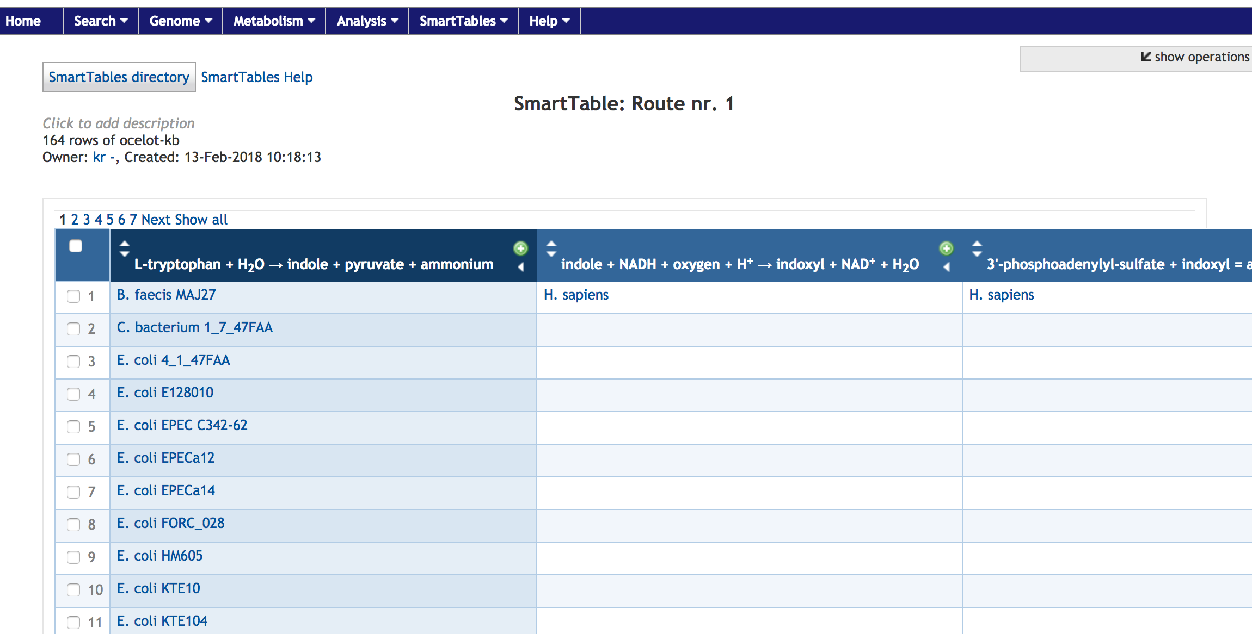
Example: Organism Table 1
Shows the organisms that can catalyze each reaction

Slide 13
Example: L-carnitine → TMAO
Implicated with accelerating atherosclerosis
Dietary L-carnitine from red meat is degradated to trimethylamine by gut microbes
The human liver converts to TMAO
Number of routes set to 2. Results in 5 seconds.
Top route: 2 reactions, 4 atoms retained

Slide 14
Example: L-carnitine → TMAO 2nd route
2nd route: 6 reactions, 4 atoms retained
Detour through γ-butyrobetaine : 4 reactions (125 organisms)
5th reaction (79 organisms), 6th reaction (only H. sapiens)
Paper: γ-butyrobetaine route 1000x higher flux, early in gut

Slide 15
Example: Autoinducer degradation
Autoinducers are compounds involved in quorum sensing, a microbial communication mechanism
Possibility of different microbes influencing each other, by manipulating autoinducers ?
Trying to examine a boundary between autoinducers productions and degradation
Acylhomoserine lactones (AHLs) are a class of autoinducers that are degraded to L-homoserine lactone. S-adenosyl-L-methionine is the key source for their synthesis.
Number of routes set to 4. Maximum time set to 120 seconds. Results in almost 2 minutes.

Slide 16
Example: Autoinducer degradation. Results
Several related routes: 2 reactions, 7 atoms retained
The center metabolites (the AHLs) differ
One of the latter set of organisms, Ralstonia sp. 5 7 47FAA, does not occur in the organism set for the first reaction
Performs solely degradation. Asymmetrical interference in the signaling mechanism ?

Slide 17
Example: Autoinducer degradation. Results 2

Slide 18
Acknowledgements
Funding sources:
  NIH National Institute of General Medical Sciences
SRI
  Mario Latendresse, Peter Karp

